Slide 1
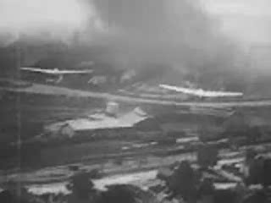

Slide 2
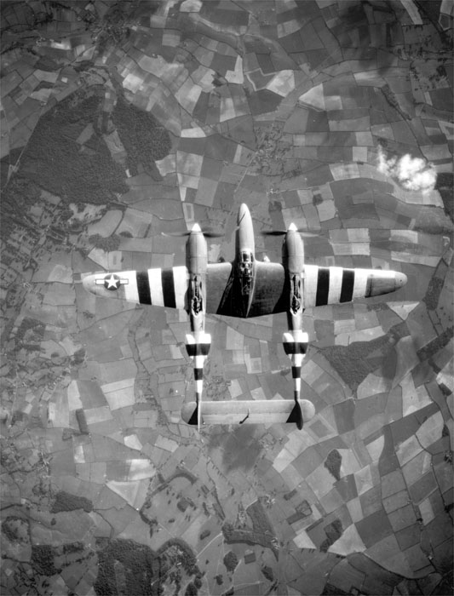

Slide 3
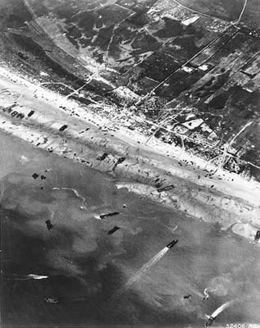
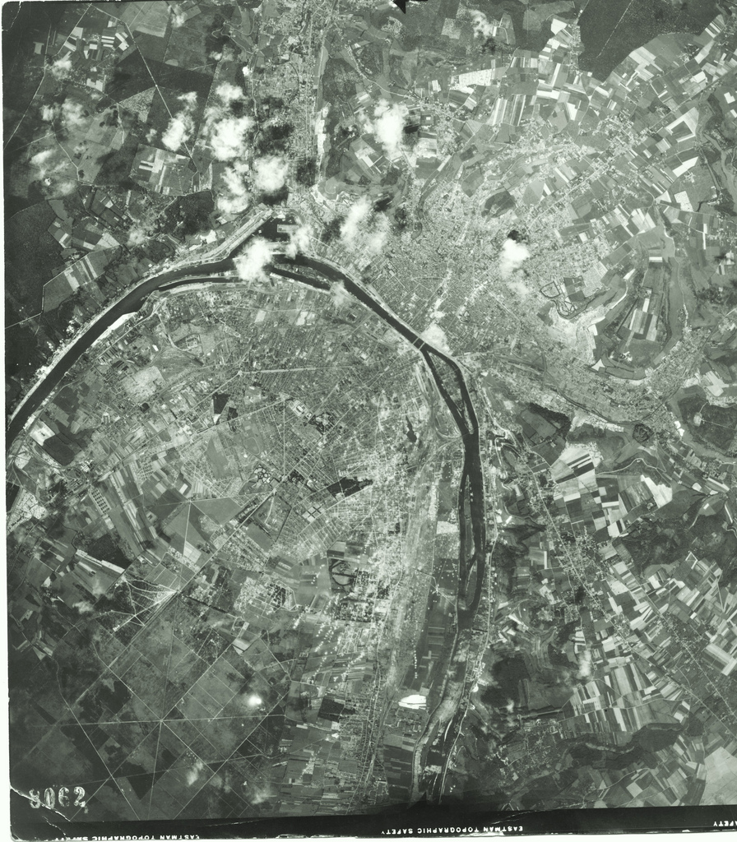

Slide 4


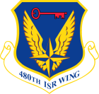
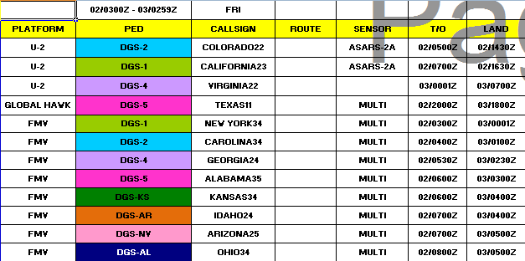
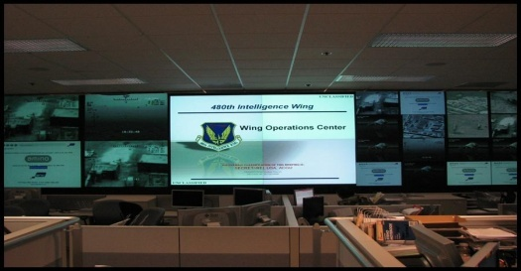
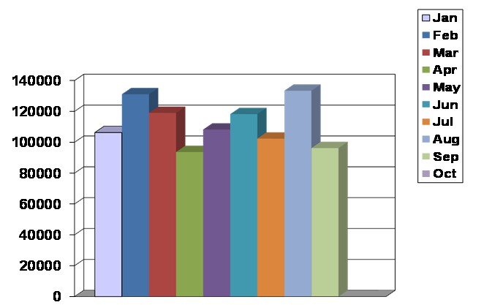
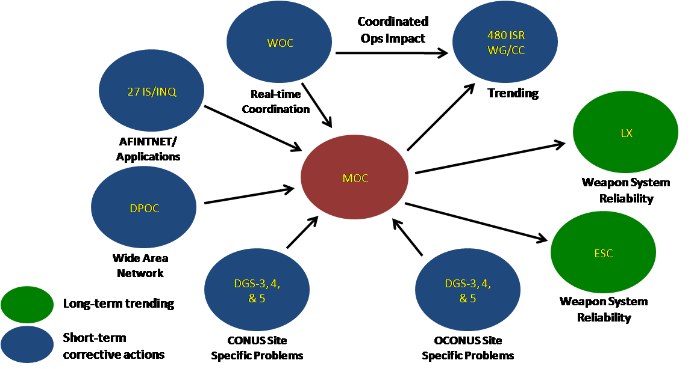
Wing Operations Center (WOC)
UNCLASSIFIED
PED C2
Network Ops
Maintenance
Dissemination
Regionally Focused – Globally Networked ISR Operations
Notes:
The Wing Operations Center consists of 4 unique mission sets. The DCGS PED Ops Center (DPOC) (point to their side of the room) administers, monitors, and manages the DCGS Wide Area Network. Their primary responsibility is network availability and to ensure the raw data, the 1’s and 0’s, are ingested into the Wide Area Network and distributed out to each of the exploitation sites. Tied to the DPOC is a security team, (point to the Security team) who is responsible for ensuring network integrity. All of the data traversing the WAN is raw date, so if someone hacks into the WAN and tampers with the 1’s and 0’s we may push inaccurate data to the exploitation sites.
This section here (point to the WOC Controllers) are the PED cmd and controllers. They perform the day to day C2 and mission mgt for the wpn sys and are responsible for development and dissemination of the PED Tasking Order. The creation of the PED Tasking Order document starts at the COCOM level where the J2 and J3 hold the Joinit Collection Mgt board. There the COCOM determines their ISR priorities and apportionment. The Air Operations Center then takes that guidance and produces the Air Tasking Order (tells the acft where to fly) and the Reconnaissance, Surveillance, and Target Acquisition Annex (RSTA) which tasks the sensor with what image to shoot or what frequency to monitor. The PED C2’ers take the ATO and RSTA and produce the PED Tasking Order. The PTO assigns mission responsibilities across the DCGS wpn sys and allocates targets for exploitation.
This section here is the Mx Ops Center and they are a C2 enabler. Their primary responsibilities are to 1. enable MX down time by working with the PED C2’ers to find pockets of opportunity within the PTO for units to perform preventative MX actions. Second, they monitor the health of the wpn sys thru a web based solution where the units inputs their systems status. That sys status is then translated into an operational impact where the PED C2’ers determine if we need to re-allocate PED tasking from one DGS to another. Finally, the MOC performs trend analysis to identify those systems that are not performing up to par and then working with AF Material Command (LX and ESC) to identify a suitable replacement in effort to improve wpn sys combat reliability.
Finally, in the front right section (point again) is the imagery dissemination team. They coordinate with each of the exploitation sites to have exploited imagery loaded onto the Wing Image Product Library (an imagery database server) so deployed forces and supported NAFs can pull that data to support IPB efforts. Additionally, the dissemination team provides key support to two other systems, Image Access Solutions and UNICORN. A demonstration of those tools will follow the conclusion of this brief.

Slide 5


